Slide 1
High-quality programming code
Teamwork
Team "Battle-Field-3"

Slide 2
Team Members
Vazzzz
Ангел Димитров
Tsigularov
Янко Цигуларов
icom85
Христо Мерджанов
georgi.neykov
Георги Нейков
Tanya
Tanya Petkova
skloser
Крум Багашев
pl0xicity
Ивайло Христов
bgotov
Борислав Готов

Slide 3
Workflow
Skype group (over 1300 messages)
Facebook group
Regular meetings at “Telerik academy”
Work plan, which is updated after every meeting
Tasks distribution

Slide 4
Workflow
GitHub repository at https://github.com/teamworkkpk/Battlefield-3-KPK
110 commits between May 25, 2014 - Jul 29, 2014

Slide 5
The Project

Slide 6
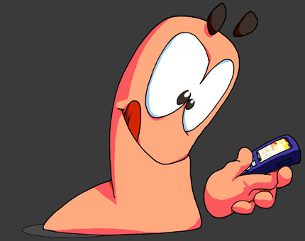
Initially it looked like this

Slide 7
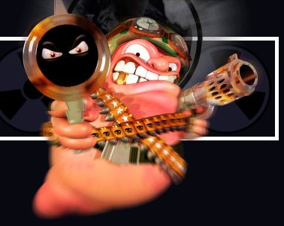
Initially it looked like this
But then it became this…

Slide 8
Battle-Field-3
Initially about 300 lines of code
After refactoring the project has almost 2000 lines
More than 100 unit tests (more than 85% code coverage)

Slide 9
Battle-Field-3
Divided game logic into main classes – Engine, Renderer, Cells, Player, Playfield, etc.
Use of interfaces to increase the abstraction
Event handlers for the gameplay and the UI
Design patterns – factory, memento, observer, fascade, iterator, singleton, etc.

Slide 10
Game features
Start menu
Count score
Save and load game
Incredibly beautiful graphics, can be played in QHD resolution ☺

Slide 11
Tools
Visual Studio
StyleCop
Sandcastle

Slide 12


